Slide 1

JCS1832 PROJECT WORK PHASE - II PERCEIVING AND PREVENTING ATTACKS IN CLOUD ENVIRONMENT VIVA VOCE Date: 30-01-2025 BATCH NO: 06
JERUSALEM COLLEGE OF ENGINEERING, CHENNAI-100
DEPARTMENT OF COMPUTER SCIENCE AND ENGINEERING
PRESENTED BY
SADHANA N(130721104072)
PRIYA DHARSHINI A(130721104061)
RAJESHWARI B(130721104067)
SUPERVISED BY
Mrs. P. MAHALAKSHMI
ASSISTANT PROFESSOR(CSE)
30-Jan-25
Department of CSE Jerusalem College of Engineering
1

Slide 2
OBJECTIVE
To explore effective methods for detecting and preventing common cloud-based attacks, specifically SQL injection and brute force attacks.
To provide practical solutions and best practices for enhancing security and resilience in cloud environments.
30-Jan-25
Department of CSE
Jerusalem College of Engineering
2

Slide 3
PROJECT DOMAIN
Cloud:
Dealing with the cloud resources involves maintaining cloud infrastructure to ensure scalability, efficiency, and security.
Cyber security:
This domain focuses on identifying potential attacks in cloud environments and implementing preventive measures access to protect cloud-based systems and data.
30-Jan-25
Department of CSE
Jerusalem College of Engineering
3

Slide 4
EXISTING SYSTEM
Many cloud platforms rely on standard firewalls and access controls to protect against unauthorized access, but these may not be enough to prevent complex attacks.
Existing systems often provide reactive security measures, responding to attacks after they happen rather than preventing them in real-time.
Many systems still use basic password protection without multi-factor authentication, making them vulnerable to brute force attacks.
30-Jan-25
Department of CSE
Jerusalem College of Engineering
4

Slide 5
LITERATURE SURVEY
Sl . No. | REFERENCE PAPER TITLE | WORK DONE IN REFERENCE PAPER | INFERENCE
1. | "Detecting SQL Injection Attacks in Cloud SaaS using Machine Learning“, D. Tripathy, R. Gohil, T. Halabi,(IEEE),2020 | Developed a machine learning-based detection system for SQL injection attacks targeting Software as a Service (SaaS) applications in the cloud. | The machine learning approach enhances the detection accuracy of SQL injection attacks, providing a robust security measure.
2. | Shail Saharan, Vishal Gupta, "Prevention of SQL Injection attacks: a comprehensive review and future directions", (ISCON)2022. | This comprehensive review discusses various SQL Injection attack prevention techniques, exploring both current practices and future directions for research in the field. | Continuous research and innovation are necessary to stay ahead of evolving sql injection threats.
3. | Aditya Kumar Shukla, Ashish Sharma, "Classification and Mitigation of Brute force Attacks Based on Self-Organizing Map and Support Vector Machine",(IEEE),2021 | This research mitigation of Brute force attacks, showcasing the effectiveness of machine learning in enhancing cloud security | Combining SOM and SVM offers a promising approach to classify and mitigate brute force attacks effectively
30-Jan-25
Department of CSE
Jerusalem College of Engineering
5

Slide 6
LITERATURE SURVEY
Sl.No. | REFERENCE PAPER TITLE | WORK DONE IN REFERENCE PAPER | INFERENCE
4. | Adarsh M G., Bhargavi K., "Double Reinforcement Learning Based Interactive GAN for Detection of Volumetric Attacks in Cloud Computing", (IEEE)2023. | The authors introduce an interactive combined with double reinforcement learning to improve the detection accuracy of volumetric DDoS. | Machine learning techniques can enhance the detection capabilities of DDoS attacks.
5. | R.A. Karthika, P. Sriramya , A. Rohini , "Detection and Classification of BRUT FORCE Attacks in Cloud Data Using Hybrid LSTM and RNN for Feature Selection", (IEEE) ,2023. | The paper presents a Recurrent Neural Networks (RNN) for the detection and classification of Brute force attacks. | Hybrid deep learning models can significantly improve the accuracy and efficiency of Brute force attack detection in cloud.
6. | "Intercept the Cloud Network from Brute Force and DDoS Attacks via Machine Learning Techniques”,M. A. Ferrag, L. Maglaras, H. Janicke,2019. | Utilized various machine learning algorithms to analyze network traffic and detect malicious activities. | The proposed system demonstrates the potential for real-time intrusion detection, contributing to improved cloud security.
30-Jan-25
Department of CSE
Jerusalem College of Engineering
6

Slide 7
LILITERATURE SURVEYLITERATURE LITERATURE SURVEYSURVEYTERATURE SURVEY
LITERATURE SURVEY
Sl.No. | REFERENCE PAPER TITLE | WORK DONE IN REFERENCE PAPER | INFERENCE
7. | John Doe et al., “A Novel Approach for Detecting SQL Injection Attacks Using Machine Learning" , (IEEE),2023. | This paper presents a machine learning-based approach for detecting SQL Injection attacks using a k-means clustering algorithm. It preprocesses data from SQL logs and uses clustering to classify and predict suspicious queries. | The method showed promising results in identifying SQL injection attacks with high accuracy and low false positives, making it a suitable solution for real-time detection in web applications.
8. | L. Sharma, P. Raj“Multiple Attack Detection Using Ensemble Learning” ,(IEEE),2022. | This paper presents an ensemble learning model for detecting multiple types of attacks, combining several classifiers to enhance detection accuracy. The study explores different ensemble techniques like boosting, bagging, and stacking. | Ensemble methods improve detection accuracy by reducing bias and variance, which is especially useful when detecting complex attack scenarios involving multiple threats.

Slide 8
PROPOSED SYSTEM
Our proposed system integrates CAPTCHA and Time Limit Authentication to prevent brute force attacks, automated bot attacks, and unauthorized access.
Uses brute force search to simulate attacks, analyze patterns, and identify vulnerabilities.
Implements a brute force detection algorithm to monitor failed login attempts.
30-Jan-25
Department of CSE
Jerusalem College of Engineering
8

Slide 9
SCOPE
The scope of this project focuses on developing a security system to detect and prevent SQL injection and brute force attacks within cloud environments.
The project will primarily aim to secure cloud-based applications by implementing measures to protect databases and user authentication systems.
30-Jan-25
Department of CSE
Jerusalem College of Engineering
9

Slide 10
HARDWARE AND SOFTWARE REQUIREMENTS
HARDWARE REQUIREMENTS:
High performance computer: Intel i5, 16GB RAM, 500 GB SSD
Networking equipments: 4G modules/ Wi-Fi
Processor:Dual core processor
SOFTWARE REQUIREMENTS:
Operating System: Windows 10
Cloud storage
Tools: Visual Studio code,wamp
30-Jan-25
Department of CSE
Jerusalem College of Engineering
10

Slide 11
SYSTEM ARCHITECTURE
Requirements analyzer
SQL injection
Cloud
Hybrid code
Brute force
Form request
Form delivery
(without SQL and Brute force attack)
User 1
User 2
User n
30-Jan-25
Department of CSE
Jerusalem College of Engineering
11

Slide 12
MODULES
PHASE I
User data module
SQL injection
PHASE II
Brute force attack
Code Generator module
Hybrid module
30-Jan-25
Department of CSE
Jerusalem College of Engineering
12

Slide 13
PHASE 1- MODULES
User data module:
User data refers to any information collected from a user, including personal details, Such as Name, age and contact details.
2.SQL injection:
SQL Injection is a web security vulnerability that allows attackers to manipulate a database query by injecting malicious SQL code into user inputs. This can lead to unauthorized access, data modification, or even deletion of an entire database.

Slide 14
PHASE II- MODULES
3.Brute force:
A Brute Force Attack is a trial-and-error method where attackers systematically try multiple username-password combinations until they gain access to an account or system.
4. Code Generator module:
A code generator is a software tool or system that automatically produces source code based on predefined rules, templates, or inputs.
5. Hybrid module:
Combine all prevention technique and provide the hybrid code which will have prevention mechanism for all attack.

Slide 15
PHASE II WORK
Focus on implementing robust security measures to improve cloud security for forms .It can be a secure form generator that automatically builds and protects user forms from SQL Injection, Brute Force Attacks, and other security threats. The generated forms can be hosted on the cloud for scalability and accessibility.

Slide 16
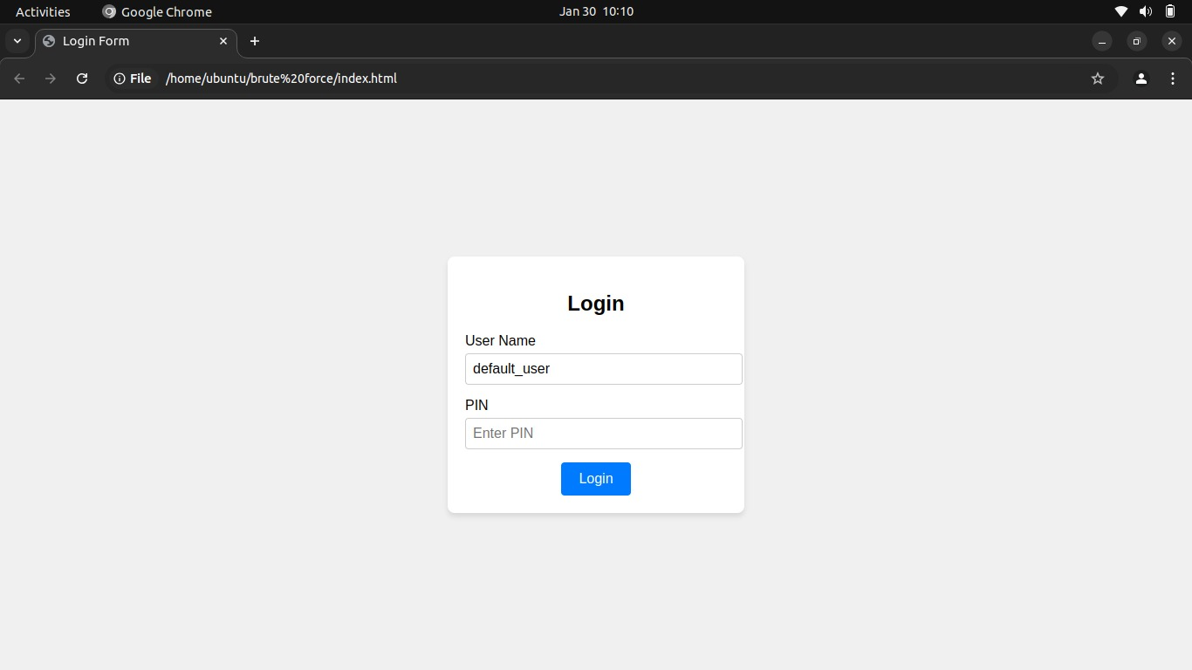
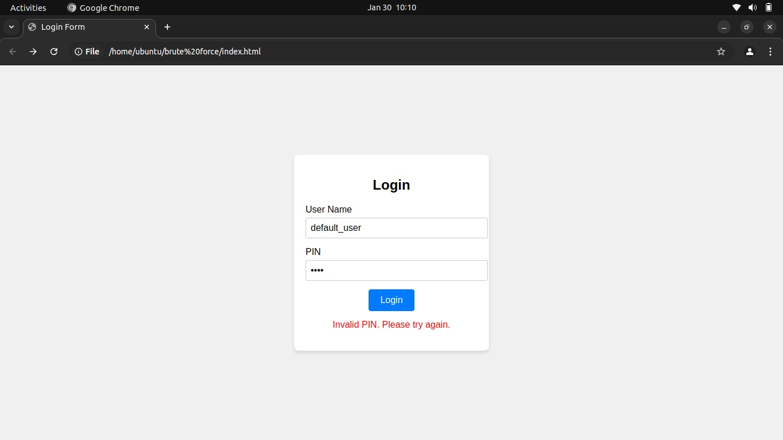
PHASE II IMPLEMENTATION

Slide 17
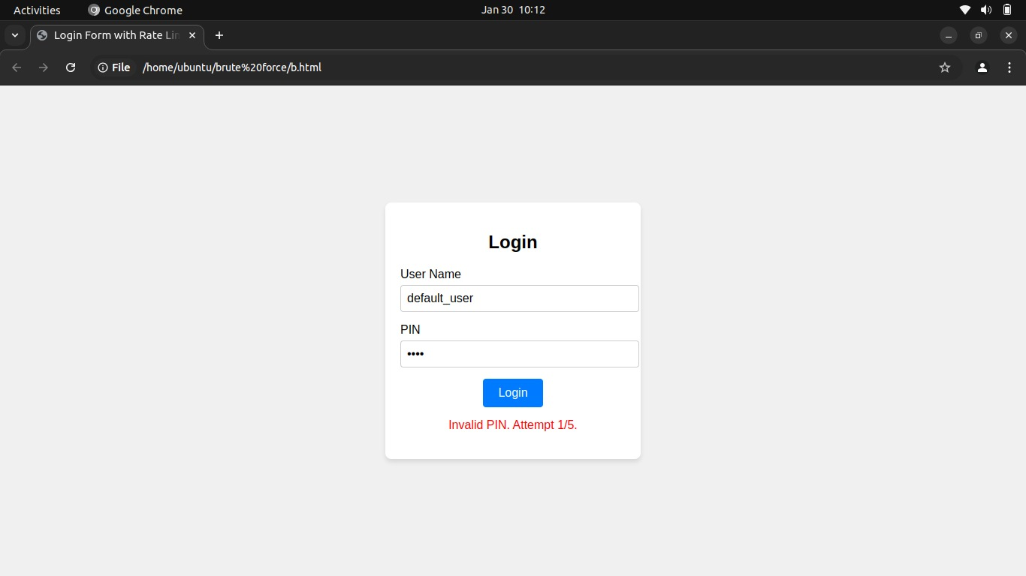
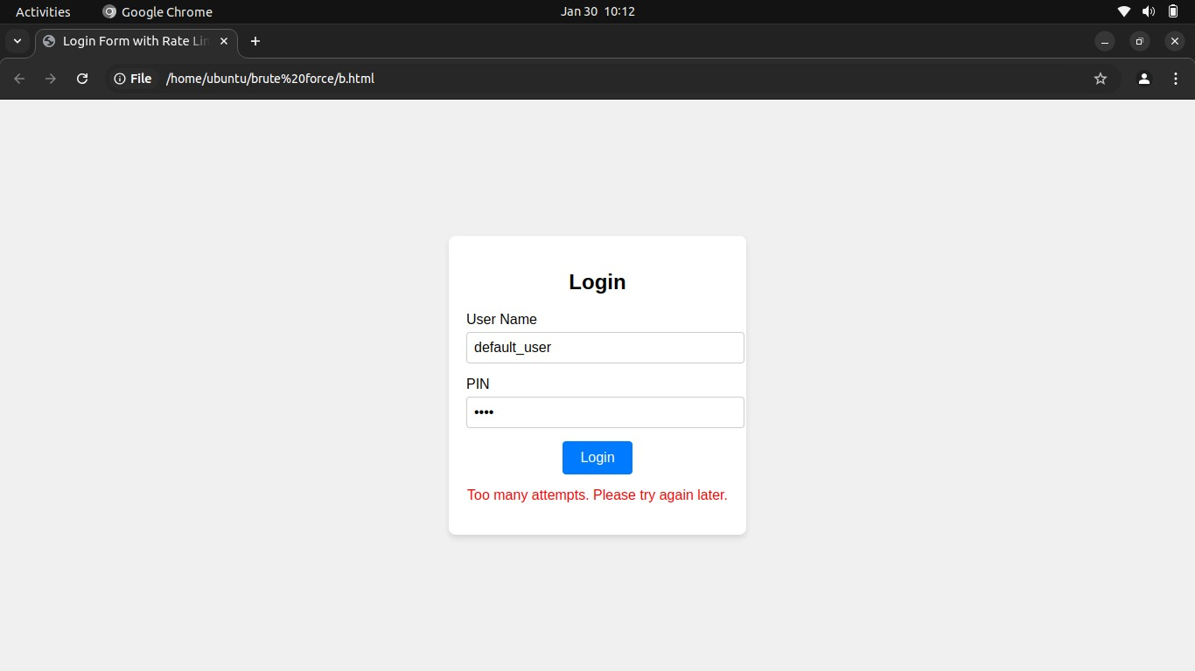
PHASE II IMPLEMENTATION

Slide 18
REFERENCES
[1] Qingyang Zhang, Chang Xu, Hong Zhong, Chengjie Gu, Jie Cui, "Revocable and Efficient Blockchain-Based Fine-Grained Access Control Against EDoS Attacks in Cloud Storage", IEEE Transactions on Computers, vol.73, no.8, pp.2012-2024,
[2]Ammar Odeh, Abobakr Aboshgifa, Nabil Belhaj, "Mitigating DDoS Attacks in Cloud Computing Environments: Challenges and Strategies",(2021) 2023.
[3]Adarsh M G., Bhargavi K., "Double Reinforcement Learning Based Interactive GAN for Detection of Volumetric Attacks in Cloud Computing", 2023 IEEE
[4] R.A. Karthika, P. Sriramya, A. Rohini, "Detection and Classification of DDoS Attacks in Cloud Data Using Hybrid LSTM and RNN for Feature Selection", 2023 International Conference on Circuit Power and Computing Technologies (ICCPCT)
30-Jan-25
Department of CSE Jerusalem College of Engineering
18

Slide 19
REFERENCES
[5] Muhammad Tehaam, Salman Ahmad, Hassan Shahid, Muhammad Suleman Saboor, Ayesha Aziz, Kashif Munir, "A Review of DDoS Attack Detection and Prevention Mechanisms in Clouds", ,(IEEE) 2023.
[6] Monika Mangla, Amaan Sayyad, Sachi Nandan Mohanty, "An AI and Computer Vision-based Face Mask Recognition & Detection System”,(IEEE) 2020.
[7] Chilla Sathvika, Vuyyuru Satwika, Yarrapothu Sruthi, Maddali Geethika, Suneetha Bulla, Swathi K, "DDoS Attack Detection on Cloud Computing Services using Algorithms of Machine Learning: Survey,(IEEE) 2020.
[8] Aditya Kumar Shukla, Ashish Sharma, "Classification and Mitigation of DDOS attacks Based on Self-Organizing Map and Support Vector Machine",(IEEE) 2021.
30-Jan-25
Department of CSE Jerusalem College of Engineering
19

Slide 20
THANK YOU

